Slide 1
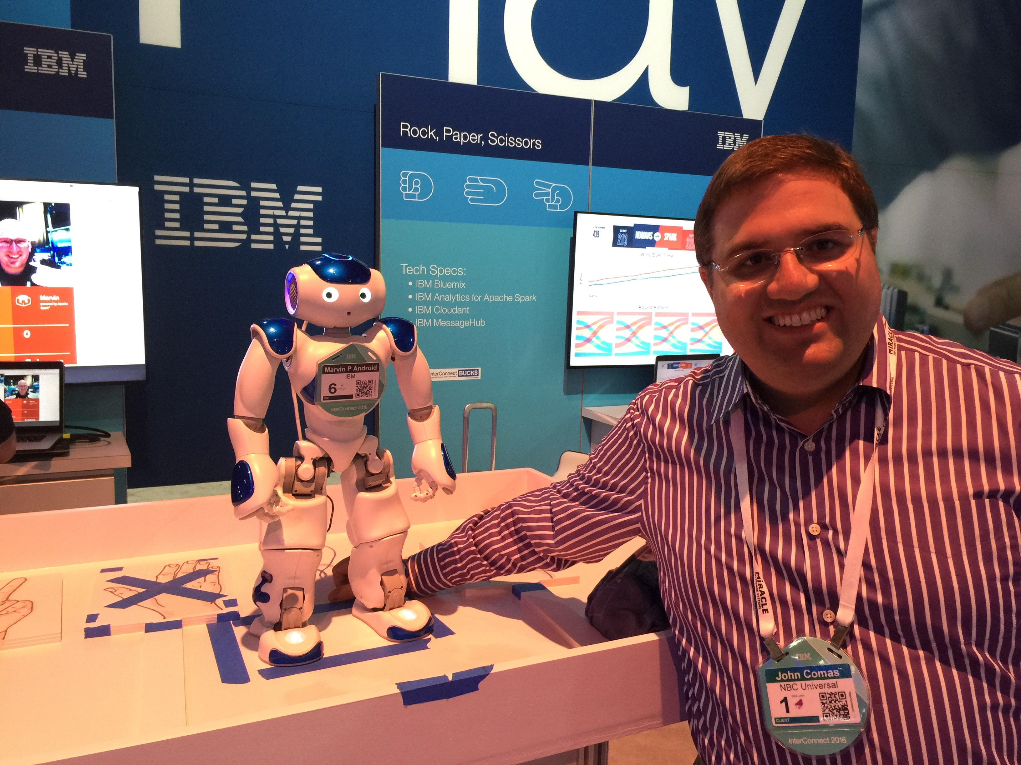
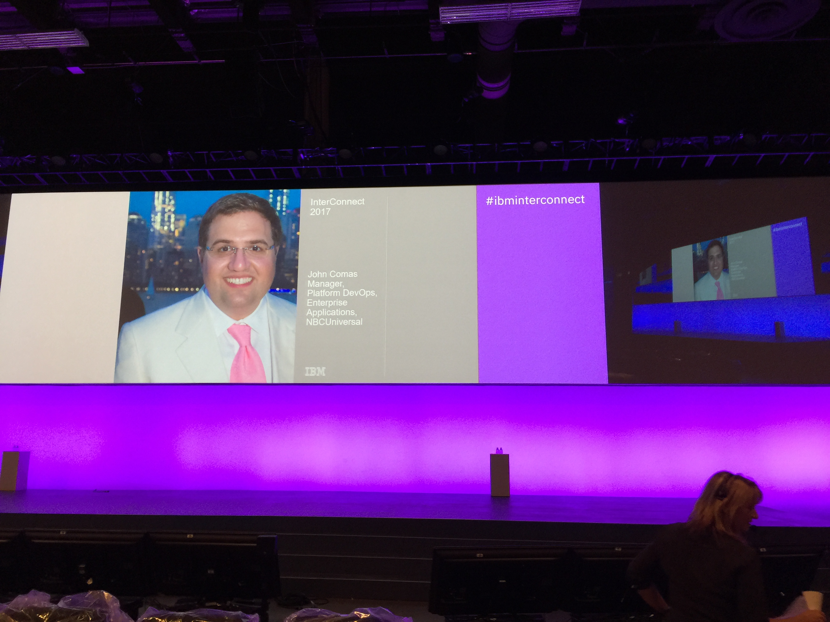

All about me – John Comas
Nearly 20 years experience in Enterprise DevOps including application lifecycle enablement, configuration management, software delivery, release management, systems integration, and site reliability engineering.
Currently Senior VP of Platform DevOps Automation for Truist
Formerly DevOps leader for barnesandnoble.com and NBCUniversal
Received PhD in Systems Engineering/DevOps from Stevens Institute of Technology in Hoboken, NJ
Lifelong advocate of advancing technology through promulgating the elegance of standardization and simplification

Slide 2

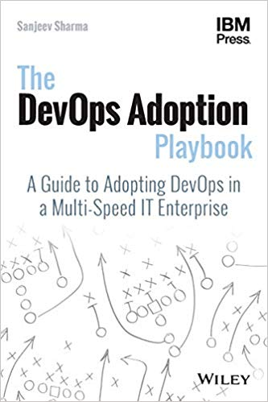
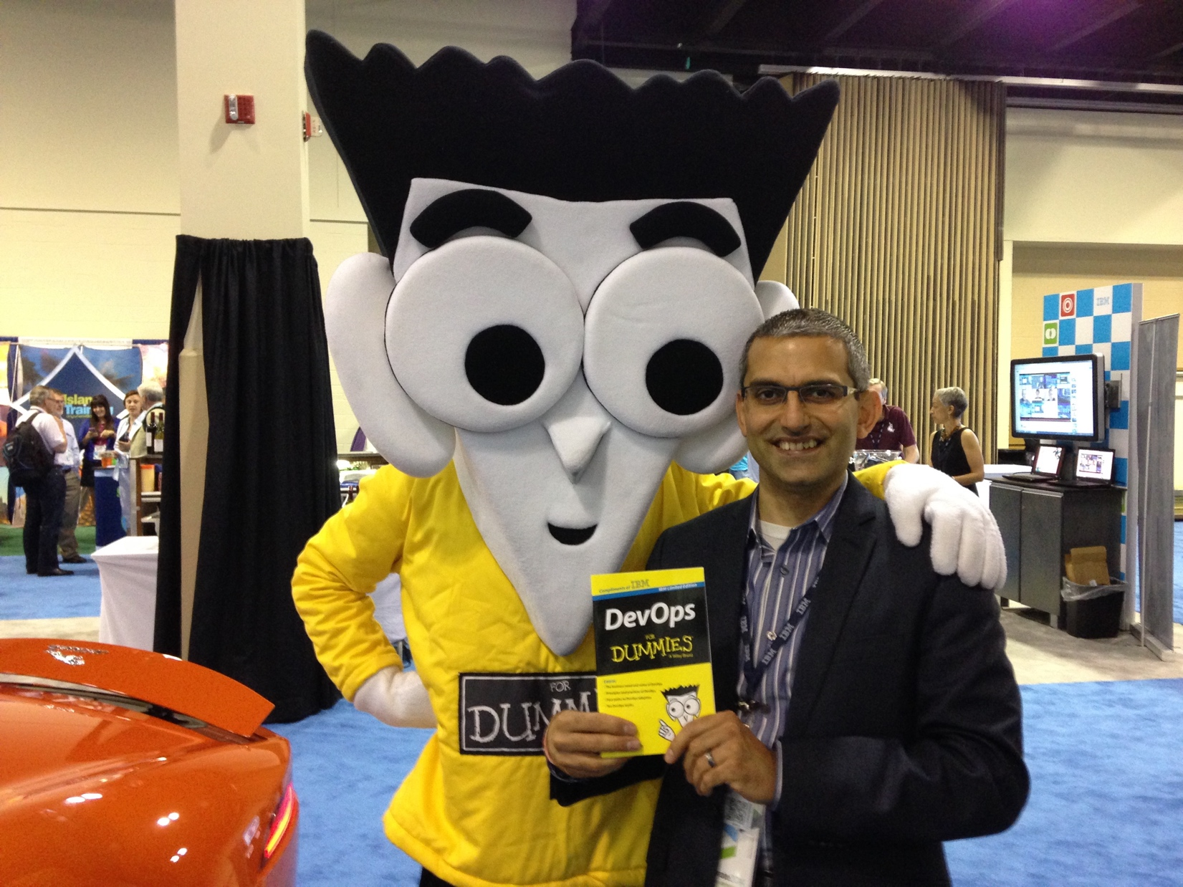
All about me – Sanjeev Sharma
25+ Years experience in Software Development and Delivery, Cloud Adoption and Data Modernization
Head of Automation and Platform Engineering at Truist
Former IBM Distinguished Engineer, and IBM’s 1st CTO for DevOps Adoption owning the DevOps practice
Conference Keynote speaker, Blogger, Podcaster and Vlogger
Author of two bestseller books:
DevOps For Dummies, IBM Edition
The DevOps Adoption Playbook: http://amzn.to/2hH7rt2

Slide 3

Introducing Truist
Headquarters: Charlotte, North Carolina
16MM clients we serve across the U.S.
17 states + D.C. – our footprint includes seven of the top 10 fastest-growing markets in the U.S.
22 community banking regions, with certain lines of business operating nationally across the U.S.
7th largest U.S. commercial bank
2,500+ branches. 3,500+ ATMs
$522B total assets. $289B loans. $398B deposits
Truist Insurance Holdings: 7th largest in the world, 6th largest broker in the U.S. with a nationwide presence
Source: https://media.truist.com/fast-facts

Slide 4
What is a Platform?

Slide 5
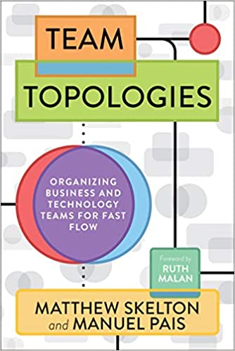
A platform is a curated experience for engineers to accelerate the delivery teams that use it - Matthew Skelton, co-author Team Topologies

Slide 6
What is a Platform for?
curated experience: as opposed to an ad-hoc experience. Another Keyword - experience
for engineers: who are your customers? Note – Engineers here used as a generic term for all stakeholders in the application delivery pipeline
to accelerate the delivery teams that use it: how to add value to the delivery teams.

Slide 7
Designing a Platform

Slide 8
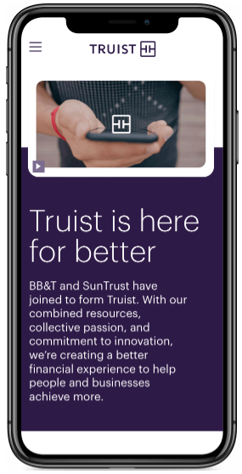
Key tenets for the platform
Self-Service
Permission to Act
Guardrails (for compliance and Security)
Environment of Trust

Slide 9

Platform as Layered Cake
A Layered approach to building a platform
Environments
Application Delivery Pipeline
Data Pipeline
Security and Compliance

Slide 10
Platform Engineering (UX, APIs, CLI, Portal)
SECURITY AND COMPLIANCE
DATA PIPELINE
APPLICATION DELIVERY PIPELINE
ENVIRONMENTS
Compute
Storage
Network

Slide 11
The Truist Engineering Platform
Platform Engineering (UX, APIs, CLI, Portal)
SECURITY AND COMPLIANCE
DATA PIPELINE
Platform Security
Data Distribution
DataSet Management
Data Privacy
Test Data Management
Schema Management
Security Validation
Platform Architecture
Delivery Analytics
APPLICATION DELIVERY PIPELINE
SCM
Build (CI)
Deploy (CD)
Test and Validate
Artifact Repo
Platform/
XaaS
Security Remediation
Test Environments
Pipeline Management
Reliability Engineering
(Chaos Engineering, SRE)
ENVIRONMENTS
Platform Audit and Compliance
Provisioning
Orchestration
Container Pipelines
Platform Performance and Availability
AIOps
Compute
Storage
Network

Slide 12
Delivering a DevSecOps Platform

Slide 13

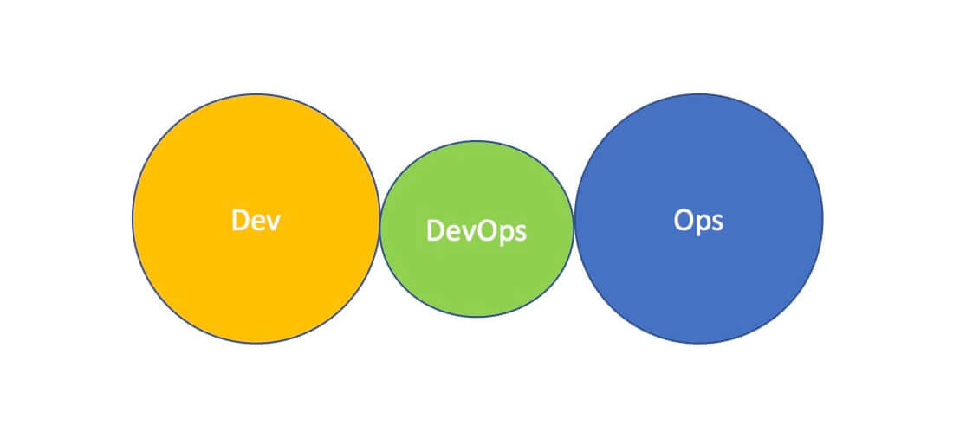
Scaling DevOps for the Enterprise
Prevent Anti-Patterns and Developing ‘DevOops’
My career has centered around implementing DevOps at scale and assessing risk for large enterprises
How do you scale the principles of DevOps across multiple large-scale disparate silos at a mega corporation?
DevOps for the enterprise may seem to be an anti-pattern in and of itself, but it surely is NOT!
If not carefully implemented, DevOps for the Enterprise may result in anti-patterns sneaking up on you!
Notes:
Continuous Build instead of Continuous Integration
DevOps as a new silo instead of an integration of the Development and Operations teams
Automating some parts of the SDLC but not others
Siloing DBAs and Database Deployment
Confusing SRE (site reliability) with DevOps (covering the entire end-to-end lifecycle continuously)
Non-standardized and/or the use of multiple team-centric DevOps frameworks creating a ‘hero’ anti-pattern
Using CD for deployment to DEV, QA, STG, but NOT PROD
Thinking of DevOps as a Tools Enablement Team

Slide 14
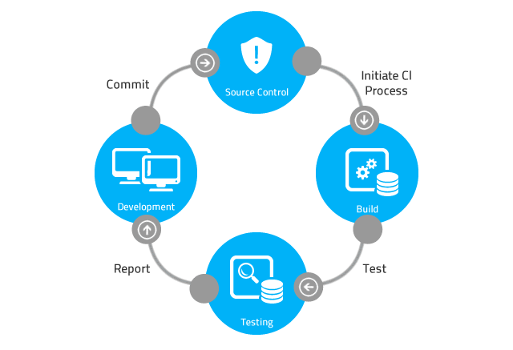




DevOps Framework
The 5 C’s of DevOps
Continuous
Monitoring / Feedback
Continuous Integration
Continuous Delivery
Continuous Testing
Continuous Compliance
Every repository commit results in a build, and code changes are merged with the mainline multiple times per day. Unit testing and TDD make up the core of your CI.
Code is developed in short sprint cycles and releases are deployed often.
Code is continually tested throughout the development cycle to ensure quality before releasing. This includes shift-left testing, function/regression QA testing, and Cyber controls.
Determine the current state of the project by compiling data from all tools in the SDLC to provide highly insightful and valuable metrics on project performance. DevOps Teams receive real-time, instant notification of production application problems.
DevOps teams receive real-time data on the IT compliance posture for regulatory, security, and operational standard benchmarks.
14
Notes:
You have to start your enterprise journey as simply as possible

Slide 15

DevOps STARR
Simplicity, Traceability, Accountability, Repeatability, Reliability
Simplicity
My Enterprise DevOps Credo:
A single, unified path to production supporting all technologies and deployment endpoints
We want to improve the quality of the code that is developed and to enable developers to write code faster and more efficiently in the simplest and most standardized way possible for the organization.
Traceability
Accountability
Repeatability
Reliability
15
Notes:
With your DevOps enterprise SDLC, you should be able to:
Build, configure, and deploy software of any platform and technology
Deploy anything anywhere: On-prem, Azure, AWS, GCP, PCF, Docker, OpenShift, mainframe, etc.
Reliability, confidently, and rapidly push out changes to PROD so PROD deployments should become a non-event
Provide constant real-time metrics, reporting, and audit

Slide 16
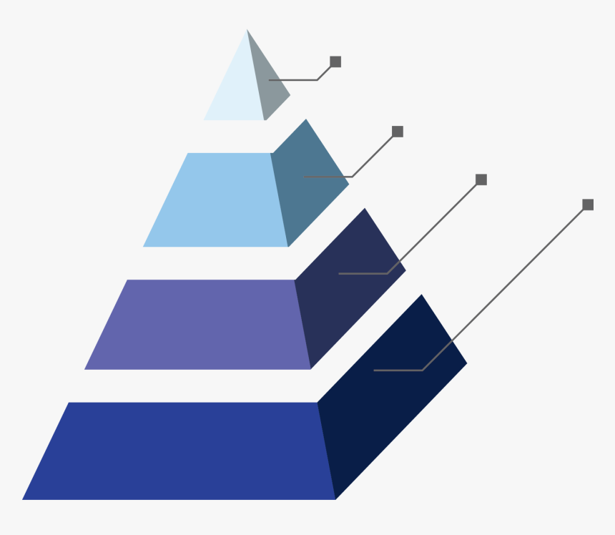
The Enterprise DevOps Tool Pyramid
As we move from DEV to PROD, the number of enterprise tools narrows…
PROD
Single Path
to PROD
Functional &
Regression Testing
STG
Enterprise Shift-Left Testing
Rich Set of Enterprise Developer Tools
QA
DEV
16
Notes:
Support All Truist Technology Stacks
Multiple Agile/Scrumfall Tools/Frameworks
Multiple Enterprise SCM choices and branching strategies
Multiple Compilation Engines (Ant, Maven, Groovy, Gradle, MSBuild, etc.)
Different Developer IDEs
SonarQube
Veracode
Black Duck
WhiteSource
HP ALM
Selenium
Enterprise PROD deployment tool standard aligned with our SDLC, P2P, and change control processes

Slide 17
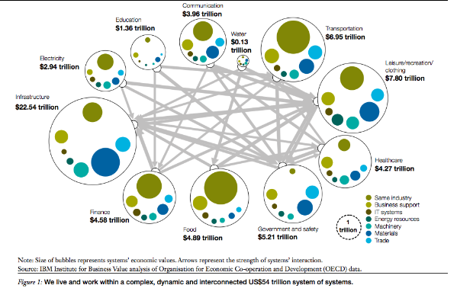
DevOps System of Systems / Risk Assessment
Assessing Risk to the System of Systems
The universe is filled with infinite numbers of complex interdependent systems which are critical to sustaining our existence.
In human culture, mother nature, and our IT systems, misunderstanding the risk of upsetting the delicate holistic balance can have disastrous consequences.
Source: https://www.solvingforpattern.org/2012/06/30/ibm-system/
Notes:
Our IT enterprises are comprised of highly complex Systems of Systems where each individual system (while capable of independent operation) interoperates with other independent systems to create a fully comprehensive system which is greater than the sum of its parts.

Slide 18
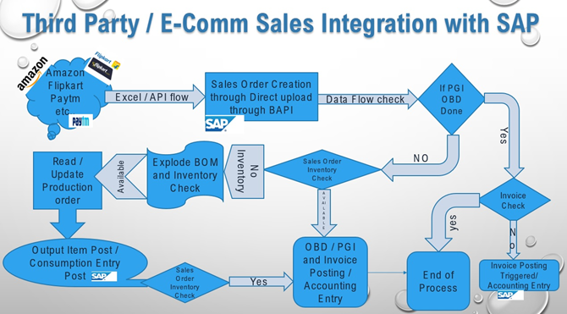
DevOps System of Systems / Risk Assessment
Assessing Risk to the System of Systems
DevOps standardization, simplification, and understanding of risk is so critically important when tinkering with enormously complex interdependent software system of systems.
Understanding transitional states during a software deployment and continually assessing risk before, during, and after the release process is absolutely essential to guaranteeing a successful rollout especially when the system has to remain LIVE!
Complex DevOps Deployment Challenges:
E-Commerce Order Fulfillment Systems
Online Loan Approval Systems
Source: https://blogs.sap.com/2019/10/09/sales-process-integration-with-third-partyweb-sales/

Slide 19

DevOps Synergization – Together Is Better
Synergize: When people work together to create a better solution than either would have built alone. Synergy is about taking good ideas and making them better by working together.
Notes:
Successful DevOps teams SYNERGIZE!
There is no one ‘hero’ in DevOps nor should there be. We are all responsible for the success of our software.
Businesses thrive when developers and ops synergize on our mutual DevOps modernization journey.
In large enterprises, DevOps engineers need to be ‘proxy-less’ and cross functional, working directly with developers, cybersecurity, QA, operations, change management, and others to effectuate change.

Slide 20
Our Platform Journey

Slide 21
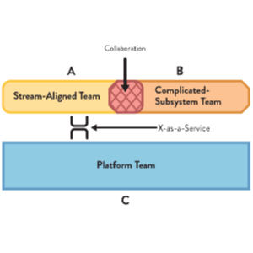
Organizing to deliver: The Platform Team
This is our team!
Stream Aligned Teams
Enabling Teams
Complicated Subsystem Teams
Platform Team

Slide 22
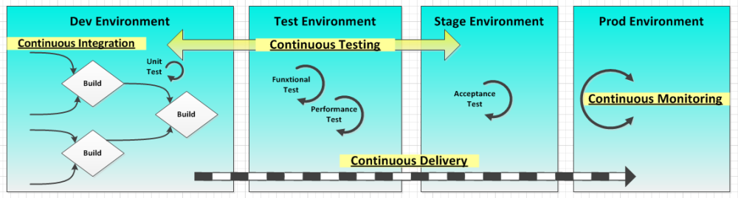
Workflow Optimization and Automation
Self–Service: Comes from end-to-end automated workflows, and a self-service portal
Permission to Act: Requires pre-approvals for well defined ‘patterns’-as-code
Guardrails (for compliance and Security): Need to be embedded in the automation, giving engineers space to be Agile
Environment of Trust: Comes from building confidence in automation over time, and including audit and risk in the journey

Slide 23
The Truist Engineering Platform - Roadmap
Platform Engineering (UX, APIs, CLI, Portal)
SECURITY AND COMPLIANCE
DATA PIPELINE
Platform Security
Data Distribution
DataSet Management
Data Privacy
Test Data Management
Schema Management
Security Validation
Platform Architecture
Delivery Analytics
APPLICATION DELIVERY PIPELINE
Full Adoption
SCM
Build (CI)
Deploy (CD)
Test and Validate
Driving Adoption
Artifact Repo
Work in Progress
Platform/
XaaS
Security Remediation
Test Environments
Pipeline Management
Reliability Engineering
(Chaos Engineering, SRE)
ENVIRONMENTS
Platform Audit and Compliance
Provisioning
Orchestration
Container Pipelines
Platform Performance and Availability
AIOps
Compute
Storage
Network

Slide 24
The Merger Journey is on …and so is our Platform Journey
2019 – The transformation begins. BB&T and SunTrust are legally now Truist.
2020 – BB&T and SunTrust roll out blended branches.
2020 – BB&T Capital Markets & SunTrust Robinson Humphrey become Truist Securities.
Early 2021 – Truist Wealth is launched.
Early 2021 – Initial Truist treasury products become available and will continue rolling out during the next several months.
Mid-2021 – Initial Truist online banking and mobile app becomes available and will continue rolling out during the next several months.
Late 2021 – Truist consumer and commercial products become available online and in BB&T branches. Current BB&T clients will see their products transition to Truist.
Early 2022 – Truist consumer and commercial products become available in SunTrust branches. Current SunTrust clients will see their products transition to Truist.
Early 2022 – Signage changes from BB&T and SunTrust to Truist at your favorite branch and ATM locations.
Early 2022 – SunTrust debit cards become Truist debit cards.
Early 2022 – BB&T and SunTrust mortgages become Truist mortgages.
Atomic Automation …to Integrated pipelines
Approval driven processes …to approvals only for outliers
Standards, Policies, and Procedures as Documents and Enforcement …to Policy-as-Code
From balancing Centralized vs Federated …to Service Providers and Consumers

Slide 25
Questions?
John Comas
Sanjeev Sharma (@sd_architect)
The Platform Team
Truist Financial Corporation

